Slide 1

cv Lab 4
Further OpenCV
Kaleem Ullah
School of electrical engineering and computer science
National University of Sciences and Technology

Slide 2
Overview
This lab will be centered on the following:
Gaussian Blur
Canny Edge Detection
Bitwise Operations
Color Spaces
InRange Function
Centroids
Perspective Transform

Slide 3
Review
To load an image:
To display an image:
To save an image:
To get image width and height:
img = cv2.imread(“file.jpg”, 1)
cv2.imshow('image1',img) cv2.waitKey(0)
cv2.destroyAllWindows()
cv2.imwrite(‘myImageRotated.jpg',imgA)
rows = img.shape[0]
cols = img.shape[1]

Slide 4
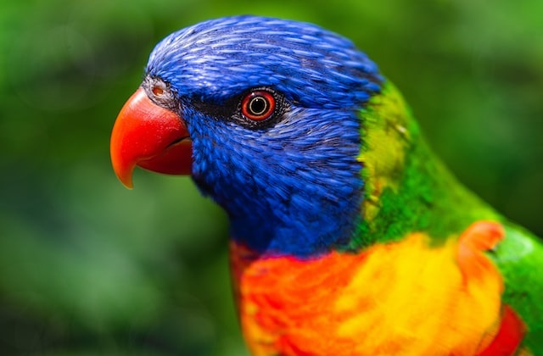
Review
To get the BGR values of a specific pixel at location (px, py), we use:
img = cv2.imread(‘bird.jpg', 1)
val = img[py, px, :]
img[24,120,:] = (255,0,0)
img[320,84,:] = (255,255,255)
img[71,120,:] = (0,0,255)
img[56,153,:] = (0,0,0)
img[200,:,:] = (0,255,0)
img[:,300,:] = (255,0,255)
img[5:80,300,:] = (88,34,14)
0
px
0
x
To change pixel colors:
py
(px,py)
y

Slide 5


Gaussian Blur
To blur an image:
The first argument is the image
The second argument is the kernel size. A larger kernel has more blurring. Kernel sizes can be 3x3, 5x5, 7x7 and so on. The size dimension must be a positive odd number
The third argument is the standard deviation of the Gaussian function. It it is set to 0, the standard deviation is calculated from the kernel size.
:
blur = cv2.GaussianBlur(img,(5,5),0)

Slide 6
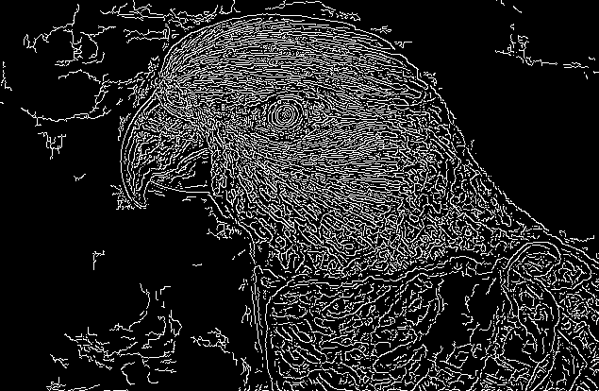
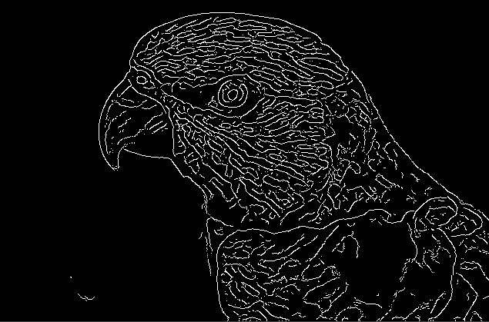
Gaussian Blur
Blurring is a preprocessing step to remove noise in the image data
Edge detection
Edge detection after blurring

Slide 7


Edge Detection
To use the Canny edge detector:
The first argument is the image
The second and third arguments are the lower and upper thresholds respectively. The thresholds are for the edge gradients. A gradient above the upper is definitely an edge. A gradient below the lower threshold is definitely not an edge. Gradient values between the thresholds are either edges or non-edges depending on their connectivity of nearby edges
:
edged = cv2.Canny(img,10,200)
Low gradient
High gradient

Slide 8






Bitwise Operations
The following bitwise operations can be used
OR AND
XOR NOT

Slide 9
Bitwise Operations
The following bitwise operations can be used
In the first three functions, both images must be the same size.
The bitwise operations are done between corresponding pixels.
Each pixel can be considered to be 0 or 1.
The 0 pixel has an intensity of 0.
The 1 pixel has an intensity greater than 0.
img3 = cv2.bitwise_and(img1,img2)
img4 = cv2.bitwise_or(img1,img2)
img5 = cv2.bitwise_xor(img1,img2)
img6 = cv2.bitwise_not(img1)

Slide 10
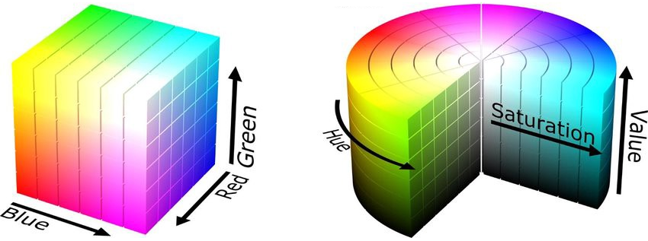
Color Spaces
To change the color space of image from BGR to HSV:
img_hsv will now have (H,S,V) values instead of (B,G,R)
:
img_hsv = cv2.cvtColor(img,cv2.COLOR_BGR2HSV)
https://medium.com/neurosapiens/segmentation-and-classification-with-hsv-8f2406c62b39
:

Slide 11
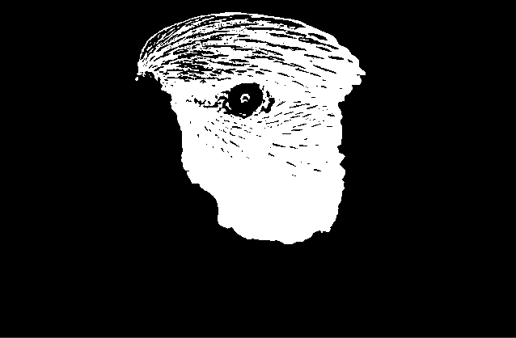
InRange Function
We can use the inRange function to get pixels that have certain values.
img2 = cv2.inRange(hsv, np.array([hmin,smin,vmin]), np.array([hmax,smax,vmax]))
Values of H, S, V range as follows:
Hue: 0-179
Saturation: 0-255
Value : 0-255
:

Slide 12
InRange Function
It is generally preferable to use HSV color space instead of BGR in order to get pixels that have a certain color
:
hsv = cv2.cvtColor(img,cv2.COLOR_BGR2HSV)
img2 = cv2.inRange(hsv, np.array([90,0,0]), np.array([150,255,230]))

Slide 13



Centroids
To get the centroid point (cx, cy), we need a binary image
M = cv2.moments(img)
if M['m00'] > 0:
cx = int(M['m10']/M['m00'])
cy = int(M['m01']/M['m00'])
Original Image Binary Image Centroid in Image

Slide 14
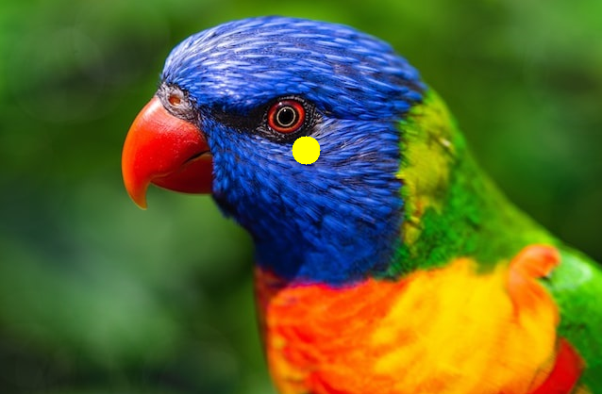
Centroids
Original Image Binary Image Centroid in Image

Slide 15
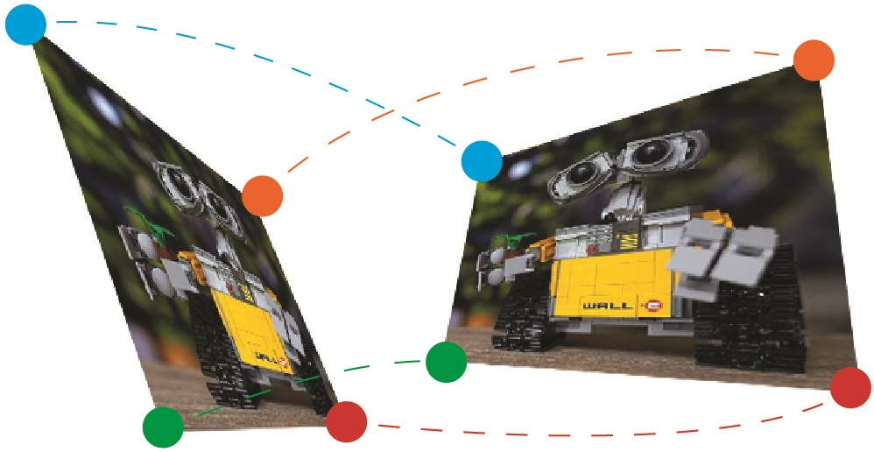
Perspective Transformation
To do perspective transformation:
pts1 = np.float32([[x1,y1],[x2,y2],[x3,y3],[x4,y4]])
pts2 = np.float32([[x5,y5],[x6,y6],[x7,y7],[x8,y8]])
M = cv2.getPerspectiveTransform(pts1,pts2)
imgP = cv2.warpPerspective(img,M,(cols,rows))

Slide 16
Lab Tasks
Download the manual from LMS
Perform the Lab Tasks as given in the manual and submit it on LMS
Remember to execute scripts with the terminal

